Slide 1
Concepts of OOP
The four main Object Oriented Programming (OOP) Concepts are as follows:
Encapsulation
Abstraction
Inheritance
Polymorphism

Slide 2
Encapsulation
Encapsulation is an Object Oriented Programming concept that binds together the data and functions that manipulates the data, and keeps safe from outside interference and misuse.
Binding (or wrapping) code and data together into a single unit is known as encapsulation. For example: capsule, it is wrapped with different medicines.
A java class is the example of encapsulation.

Slide 3
Data Abstraction
Data abstraction refers to providing only essential information to the outside world and hiding their background details, i.e., to represent the needed information in program without presenting the details.
It is a programming (and design) technique that relies on the separation of interface and implementation.
For example: Phone call, we don't know the internal processing.
In java, we use abstract class and interface to achieve abstraction.

Slide 4
Inheritance
When one object acquires all the properties and behavior's of parent object, it is known as inheritance.
It provides code reusability.
It is used to achieve runtime polymorphism.
The idea of inheritance implements the is a relationship. For example, mammal IS-A animal, dog IS-A mammal hence dog IS-A animal as well and so on.

Slide 5
Polymorphism
When one task is performed by different ways i.e., known as polymorphism. For example: to convince the customer differently, to draw something e.g. shape or rectangle etc.
In java, we use method overloading and method overriding to achieve polymorphism.
Another example can be to speak something e.g. cat speaks meow, dog barks woof etc.

Slide 6
What is an Object?
An entity that has state and behavior is known as an object e.g. chair, bike, marker, pen, table, car etc.
It can be physical or logical (tangible and intangible). The example of intangible object is banking system
An object has three characteristics:
State: Value of the object. It is represented by attributes of object.
Behavior: Functionality of object. It is represented by methods of object.
Identity: It gives unique name to object and enable one object to interact with other objects.
For example, Pen is an object. Its name is Reynolds, color is white etc. known as its state. It is used to write, so writing is its behavior.
In OOP terms an object is an instance of a class.

Slide 7
What is a Class?
A class is nothing but a blueprint or a template for creating different objects which defines its properties and behaviors.
Java class objects exhibit the properties and behaviors defined by its class.
A class is a collection of fields (data) and methods (functions) that operate on that data.

Slide 8




A Java program consists of one or more classes.
A class is an abstract description of objects.
Here is an example class:
class Dog { ...description of a dog goes here... }
Here are some objects of that class:

Slide 9
In general, class declarations can include these components, in order:
Modifiers: A class can be public or has default access.
Class name: The name should begin with a initial letter (Capital by convention).
Superclass (if any): The name of the class’s parent (superclass), if any, preceded by the keyword extends. A class can only extend (subclass) one parent.
Interfaces(if any): A comma-separated list of interfaces implemented by the class, if any, preceded by the keyword implements. A class can implement more than one interface.
Body: The class body surrounded by braces, { }.

Slide 10
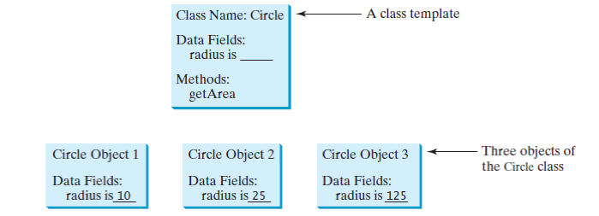

Slide 11
class classname
{
type instance-variable1;
type instance-variableN;
type method_name1(parameter-list)
{
// body of method
}
}
public class Dog
{
String breed;
int ageC;
String color;
void barking()
{ }
void hungry()
{ }
void sleeping()
{ }
}

Slide 12
A class can contain any of the following variable types:
Local variables: Variables defined inside methods, constructors or blocks are called as local variables. The variable will be declared and initialized within the method and the variable will be destroyed when the method has completed.
Instance variables: Instance variables are variables within a class but outside any method. These variables are initialized when the class is instantiated. Instance variables can be accessed from inside any method, constructor or blocks of that particular class.
Class variables: Class variables are variables declared within a class, outside any method, with the static keyword.

Slide 13
Creating an Object
As mentioned previously, a class provides the blueprints for objects. So, basically an object is created from a class. In Java, the new keyword is used to create new objects.
There are three steps when creating an object from a class:
Declaration: A variable declaration with a variable name with an object type.
Instantiation: The 'new' keyword is used to create the object.
Initialization: The 'new' keyword is followed by a call to a constructor. This call initializes the new object.

Slide 14
Creating an Object
public class Dog
{
String breed;
int age;
String color;
void barking()
{
System.out.println ( “Bark”);
}
}
Dog myDog = new Dog();

Slide 15
Methods
Methods are similar to procedures, functions, or sub-routines.
Statements within a method execute only when the method is called.
To execute a method, you call it from another method.
“The calling method makes a method call.”

Slide 16
Method Declaration
Is the first line or header of a method it contains the following:
Optional access modifiers.
The return type for the method.
The method name.
An opening parenthesis.
An optional list of method arguments separated by commas.
A closing parenthesis.

Slide 17
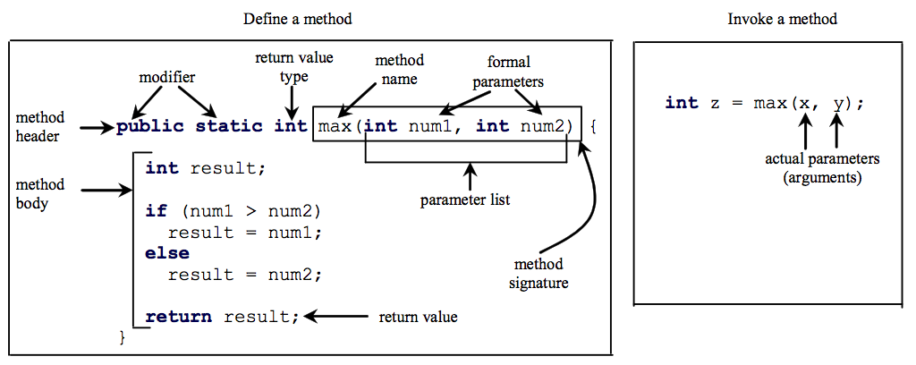

Slide 18
Access Modifiers
Public – accessible anywhere.
Private – accessible only within the class in which it is defined.
Protected – allows members of a derived class to access members of its parent classes.
Static – does not require instantiation before it can be used and remains in place after use, without being destroyed.

Slide 19
Special Methods
main() method
constructors
main() method
Execution starts from main() method
main is defined as
public static void main(String[] args)
public: so that it may be accessed outside the class by JVM
static: need not to create any instance (object) to call main() by JVM
void: does not return any value to JVM
main: registered name of the method to be called by JVM
String[] args: command line arguments of String type

Slide 20
Method Overloading in Java
If two or more method in a class have same name but different parameters, it is known as method overloading. Overloading always occur in the same class.
Method overloading is one of the ways through which java supports polymorphism.
Method overloading can be done by:
changing number of arguments.
by changing the data type of arguments.
If two or more method have same name and same parameter list but differs in return type are not said to be overloaded method.
Overloaded method can have different access modifiers.

Slide 21
Method overloading by changing data type of arguments
class Calculate
{
void sum (int a, int b)
{
System.out.println("sum is"+(a+b)) ;
}
void sum (float a, float b)
{
System.out.println("sum is"+(a+b));
}
public static void main (String[] args)
{
Calculate cal = new Calculate();
cal.sum (8,5); //sum(int a, int b) is method is called.
cal.sum (4.6f, 3.8f); //sum(float a, float b) is called.
}
}

Slide 22
Method overloading by changing data type of arguments
class Calculate
{
void area (int l, int b)
{
System.out.println ("Area is”+ ( l * b ) ) ;
}
void area (int l, int b, int h)
{
System.out.println ("Area is”+(l * b * h) );
}
public static void main (String[] args)
{
Calculate cal = new Calculate();
cal.area(8,5); //area(int l, int b) is method is called.
cal.area (4, 6, 2); //area(int l, int b, int h) is called.
}
}

Slide 23
Constructors
Constructors are a special kind of methods that are invoked to construct objects.
Constructors are invoked using the new operator when an object is created.
Rules for Constructor creation
Constructors must have the same name as the class itself.
Constructors do not have a return type—not even void.

Slide 24
Types of Java Constructors
No-Arg Constructor - a constructor that does not accept any arguments.
Default Constructor - a constructor that is automatically created by the Java compiler if it is not explicitly defined.
Parameterised constructor - used to specify specific values of variables in object.
No argument Constructor
Parameterised Constructor
Circle()
{
}
Circle(double newRadius)
{
radius = newRadius;
}

Slide 25
Constructors are invoked using the new operator when an object is created.
new ClassName();
Example:
new Circle(); // creating object using no argument constructor
new Circle(5.0); // creating object using parameterized constructor

Slide 26
Default Constructors
Class Dog
{
Dog ( )
{
System.out.println (“ Dog object is created );
}
Public static void main ( String args [ ] )
{
Dog d = new Dog ( );
}
}

Slide 27
Parameterised Constructors:
class Student
{
int id;
String name;
Student (int i,String n)
{
id = i;
name = n;
}
void display()
{
System.out.println(id+" “+name);
}
public static void main (String args [ ] )
{
Student4 s1 = new Student4(111,"Karan");
Student4 s2 = new Student4(222,"Aryan");
s1.display();
s2.display();
}
}

Slide 28
Constructor Overloading in Java
Like methods, a constructor can also be overloaded.
Overloaded constructors are differentiated on the basis of their type of parameters or number of parameters.
Constructor overloading is not much different than method overloading. In case of method overloading you have multiple methods with same name but different signature, whereas in Constructor overloading you have multiple constructor with different signature but only difference is that Constructor doesn't have return type in Java.

Slide 29
class Student {
int id;
String name;
int age;
Student (int i,String n){
id = i;
name = n; }
Student (int i,String n,int a){
id = i;
name = n;
age=a; }
void display( ){
System.out.println(id+" "+name+" "+age);}
public static void main(String args[]){
Student s1 = new Student5(111,"Karan");
Student s2 = new Student5(222,"Aryan",25);
s1.display();
s2.display(); }
}
OUTPUT:
111 Karan 0
222 Aryan 25

Slide 30
Differences between Java Constructor and Java Method
Java Constructor | Java Method
Constructor is used to initialize the state of an object. | Method is used to expose behaviour of an object.
Constructor must not have return type. | Method must have return type.
Constructor is invoked implicitly. | Method is invoked explicitly.
The java compiler provides a default constructor if you do not have any constructor. | Method is not provided by compiler in any case.
Constructor name must be same as the class name. | Method name may or may not be same as class name.

Slide 31
“this” keyword
‘this’ keyword refers to current object inside method or constructors.
Used to
To refer to hidden data field of class.
To enable a constructor to invoke other. Constructor of same class
class Box
{
Double width, height, depth;
Box (double w, double h, double d)
{
this.width = w;
this.height = h;
this.depth = d;
}
}

Slide 32
Object Class
Object class is present in java.lang package.
Every class in Java is directly or indirectly derived from the Object class.
If a Class does not extend any other class then it is direct child class of Object and if extends other class then it is an indirectly derived. Therefore the Object class methods are available to all Java classes.
Hence Object class acts as a root of inheritance hierarchy in any Java Program.

Slide 33
Self Assessment Questions
Which of these class is super class of every class in Java?
String class
Object class
Abstract class
ArrayList class
Answer: Object class

Slide 34
Self Assessment Questions
What is the return type of a method that does not returns any value?
int
float
void
double
Answer: void

Slide 35
Self Assessment Questions
What is the process of defining more than one method in a class differentiated by method signature?
Function overriding
Function overloading
Function doubling
None of the mentioned
Answer: Function overloading

Slide 36
Self Assessment Questions
Which method can be defined only once in a program?
main method
finalize method
static method
private method
Answer: main method

Slide 37
Self Assessment Questions
Which of these statements is incorrect?
All object of a class are allotted memory for the all the variables defined in the class.
If a function is defined public it can be accessed by object of other class by inheritance.
Main() method must be made public.
All object of a class are allotted memory for the methods defined in the class.
Answer: All object of a class are allotted memory for the methods defined in the class.

Slide 38
Self Assessment Questions
Which of the following is a method having same name as that of it’s class?
Finalize
Delete
Class
constructor
Answer: constructor

Slide 39
Inheritance
Inheritance in java is a mechanism in which one object acquires all the properties and behaviors of parent object.
The idea behind inheritance in java is that you can create new classes that are built upon existing classes.
When you inherit from an existing class, you can reuse methods and fields of parent class, and you can add new methods and fields also.
Inheritance defines an is-a relationship between a super-class and its subclasses. It means that the subclass (child) is a more specific version of the super-class (parent).
The inheritance relationship is transitive: if class y extends class x, and a class z extends class y, then z will also inherit from class x.
Inheritance is uni-directional. For example House is a Building. But Building is not a House.

Slide 40
Classes, Inheritance, Package and Interfaces
Syntax of Java Inheritance
class Subclass-name extends Superclass-name
{
//methods and fields
}
The extends keyword indicates that you are making a new class that derives from an existing class.
In the terminology of Java, a class that is inherited is called a super class. The new class is called a subclass.

Slide 41
Classes, Inheritance, Package and Interfaces
Shape
Circle
Rectangle
Square

Slide 42
Classes, Inheritance, Package and Interfaces
class Shape
{
int area ( )
{…}
}
class Rectangle extends Shape
{
int area()
{ area = length * width;}
int length;
int width;
}
class Square extends Rectangle
{
int area() {…}
int length;
int width = length;
}

Slide 43
Classes, Inheritance, Package and Interfaces
Types of Inheritance:
Single inheritance
Multilevel inheritance
Hierarchical inheritance
Multiple inheritance
Hybrid inheritance

Slide 44
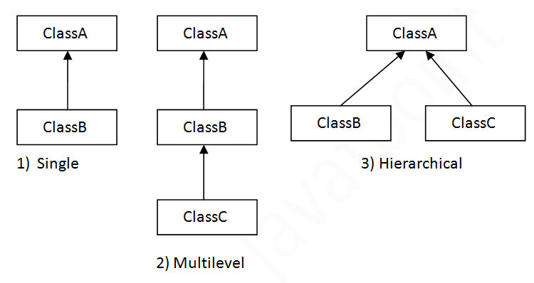
Classes, Inheritance, Package and Interfaces
Can be implemented by using class and object.

Slide 45
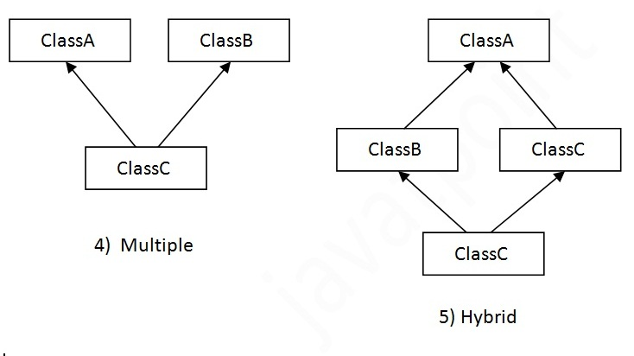
Classes, Inheritance, Package and Interfaces
Can be implemented by using interface.

Slide 46
Classes, Inheritance, Package and Interfaces
Single Inheritance:
class Animal
{
void eat()
{.
System.out.println(“eating…”);
}
}
class Dog extends Animal
{
void bark()
{.
System.out.println(“barking…");
}
}
class TestInheritance
{
public static void main(String args[])
{
Dog d=new Dog();
d.bark();
d.eat();
}
}

Slide 47
Classes, Inheritance, Package and Interfaces
Multilevel Inheritance:
class Animal
{
void eat().
{
System.out.println ( “eating...");
}
}
class Dog extends Animal
{
void bark()
{
System.out.println (“barking...");
}
}
class BabyDog extends Dog
{
void weep()
{
System.out.println (“weeping...");
}
}
class TestInheritance2
{
public static void main(String args[])
{
BabyDog d=new BabyDog();
d.weep();
d.bark();
d.eat();
}
}

Slide 48
Classes, Inheritance, Package and Interfaces
Hierarchical Inheritance:
class Animal
{
void eat()
{
System.out.println(“eating...");
}
}
class Dog extends Animal
{
void bark()
{
System.out.println(“barking...");
}
}
class Cat extends Animal
{
void meow()
{
System.out.println(“meowing...");
}
}
class TestInheritance3
{
public static void main(String args[])
{
Cat c=new Cat();
c.meow();
c.eat();
//c.bark();//C.T.Error
}
}

Slide 49
Classes, Inheritance, Package and Interfaces
Multiple Inheritance:
The mechanism of inheriting the features of more than one base class into a single class is known as multiple inheritance.
To reduce the complexity and simplify the language, multiple inheritance is not supported in java.
Java does not support multiple inheritance but the multiple inheritance can be achieved by using the interface.
In Java Multiple Inheritance can be achieved through use of Interfaces by implementing more than one interfaces in a class.

Slide 50
Classes, Inheritance, Package and Interfaces
‘SUPER’ keyword
A subclass inherits the accessible data fields and methods from its superclass, but the constructors are not inherited in the subclass.
They can only be invoked from constructors of the subclasses using the keyword super.
The keyword super refers to the superclass of the class in which super appears.
Syntax: super (arguments)
EXAMPLE: SuperDemo.java

Slide 51
Classes, Inheritance, Package and Interfaces
class Vehicle
{
Vehicle()
{
System.out.println("Vehicle is created”);
}
}
class Bike extends Vehicle
{
Bike()
{
//will invoke parent class constructor
super();
System.out.println("Bike is created");
}
public static void main(String args[])
{
Bike b=new Bike();
}
}

Slide 52
Classes, Inheritance, Package and Interfaces
The superclass constructor call must be the first statement in the body of subclass constructor.
If one doesn't insert super, the compiler implicitly inserts supers(); at the beginning of the subclass’ default constructor to call the superclass’ default constructor.
When we create an instance of the subclass, it invokes the constructor of all the super-classes along with inheritance chain.
A superclass constructor can only called from subclass constructor. Any other subclass method cannot call it.
This is used to call another constructor of same class, super is used to call constructor of its super class.

Slide 53
Classes, Inheritance, Package and Interfaces
Usage of java super Keyword:
super is used to refer immediate parent class instance variable.
super() is used to invoke immediate parent class constructor.
super is used to invoke immediate parent class method.

Slide 54
Classes, Inheritance, Package and Interfaces
Super is used to refer immediate parent class instance variable.
class Vehicle
{
int speed=50;
}
class Bike extends Vehicle
{
int speed=100;
void display()
{
//will print speed of Vehicle now
System.out.println(super.speed);
}
public static void main(String args[])
{
Bike b=new Bike();
b.display();
}
}

Slide 55
Classes, Inheritance, Package and Interfaces
Super is used to invoke parent class constructor.
class Vehicle
{
Vehicle()
{
System.out.println("Vehicle is created”);
}
}
class Bike extends Vehicle
{
Bike()
{
super();
//will invoke parent class constructor
System.out.println("Bike is created");
}
public static void main(String args[])
{
Bike b=new Bike();
}
}

Slide 56
Classes, Inheritance, Package and Interfaces
Super can be used to invoke parent class method
class Person{
void message()
{
System.out.println(“welcome”);
}
}
class Student extends Person
{
void message()
{
System.out.println(“welcome to java”);
}
void display()
{
message();
//will invoke current class message() method
super.message(); //will invoke parent class message() method
}

Slide 57
Classes, Inheritance, Package and Interfaces
Method Overriding
Method overriding means having a different implementation of the same method in the inherited class.
These two methods would have the same signature, but different implementation.
One of these would exist in the base class and another in the derived class. These cannot exist in the same class.
Usage:
Method overriding is used to provide specific implementation of a method that is already provided by its super class.
Method overriding is used for runtime polymorphism.

Slide 58
Classes, Inheritance, Package and Interfaces
Method Overriding rules
Method must have same name as in the parent class.
Method must have same parameter as in the parent class.
Method must be IS-A relationship (inheritance).

Slide 59
Classes, Inheritance, Package and Interfaces
class Vehicle
{
void run()
{
System.out.println ("Vehicle is running”);
}
}
class Bike extends Vehicle
{
void run()
{
System.out.println("Bike is running safely”);
}
public static void main(String args[])
{
Bike obj = new Bike();
obj.run();
}
}

Slide 60
Classes, Inheritance, Package and Interfaces
No. | Method Overloading | Method Overriding
1) | Method overloading is used to increase the readability of the program. | Method overriding is used to provide the specific implementation of the method that is already provided by its super class.
2) | Method overloading is performed within class. | Method overriding occurs in two classes that have IS-A (inheritance) relationship.
3) | In case of method overloading, parameter must be different. | In case of method overriding, parameter must be same.
4) | Method overloading is the example of compile time polymorphism. | Method overriding is the example of run time polymorphism.
5) | In java, method overloading can't be performed by changing return type of the method only. Return type can be same or different in method overloading. But you must have to change the parameter. | Return type must be same or covariant in method overriding.

Slide 61
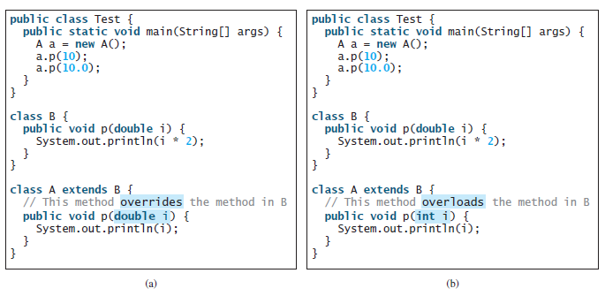
Classes, Inheritance, Package and Interfaces

Slide 62
Classes, Inheritance, Package and Interfaces
Final Keyword
The final keyword in java is used to restrict the user. The java final keyword can be used in many context.
Final can be:
Variable
Method
Class.
Final Keyword can do following:
Stop change in values
Stop method overriding
Stop inheritance

Slide 63
Classes, Inheritance, Package and Interfaces
If you make any variable as final, you cannot change the value of final variable (It will be constant)
class Bike
{
final int speedlimit=90; //final variable
void run()
{
speedlimit=400;
}
public static void main(String args[])
{
Bike obj=new Bike();
obj.run();
}
}

Slide 64
Classes, Inheritance, Package and Interfaces
If you make any method as final, you cannot override it.
class Bike
{
final void run(){
System.out.println("running");}
class Honda extends Bike{
void run()
{System.out.println("running safely with 100kmph");} //ERROR
public static void main(String args[])
{
Honda h= new Honda();
h.run();
}
}

Slide 65
Classes, Inheritance, Package and Interfaces
If you make any class as final, you cannot extend it.
final class Bike{}
class Honda1 extends Bike//ERROR
{
void run()
{
System.out.println ("running safely with 100kmph”);
}
public static void main(String args[])
{
Honda1 honda= new Honda();
honda.run();
}
}

Slide 66
Classes, Inheritance, Package and Interfaces
Self Assessment Questions
Which inheritance in java programming is not supported?
Multiple inheritance using classes
Multiple inheritance using interfaces
Multilevel inheritance
Single inheritance
Answer: Multiple inheritance using classes

Slide 67
Classes, Inheritance, Package and Interfaces
Self Assessment Questions
What is subclass in java?
A subclass is a class that extends another class
A subclass is a class declared inside a class
Both above.
None of the above.
Answer: A subclass is a class that extends another class

Slide 68
Classes, Inheritance, Package and Interfaces
Self Assessment Questions
Order of execution of constructors in Java Inheritance is
Derived to base class
Base to derived class
Random order
None
Answer: Base to derived class

Slide 69
Classes, Inheritance, Package and Interfaces
Self Assessment Questions
Which of the following is true about inheritance in Java.
In Java all classes inherit from the Object class directly or indirectly. The Object class is root of all classes.
Multiple inheritance is not allowed in Java.
Unlike C++, there is nothing like type of inheritance in Java where we can specify whether the inheritance is protected, public or private.
1 and 3
1 and 2
2 and 3
1 ,2 and 3
Answer: 1, 2 and 3

Slide 70
Classes, Inheritance, Package and Interfaces
Self Assessment Questions
Which class cannot be sub classed?
final class
object class
abstract class
child class
Answer: final class

Slide 71
Classes, Inheritance, Package and Interfaces
What is Package?
A package is a namespace that organizes a set of related classes and interfaces.
A Java package is a mechanism for organizing Java classes into namespaces.
A package is a logical container of classes, interfaces and sub-packages.
Package provides unique namespace for classes (i.e. facility of uniquely identifying a class or interface and resolving name conflicts).
If a class or interface is stored in a package, then it is referenced by using the package name.

Slide 72
Classes, Inheritance, Package and Interfaces
What is the need of Package?
A unique name should be used for each class to avoid name collisions.
Without some way to manage the name space, we could run out of convenient, descriptive names for individual classes.

Slide 73
Classes, Inheritance, Package and Interfaces
Reasons to use packages:
Grouping related classes.
In large programs prevents name conflicts.
Allows effective use of default "package" visibility.

Slide 74
Classes, Inheritance, Package and Interfaces
Defining a Package:
Each file may have a package declaration which precedes all non-comment code.
The package name must be the same as the enclosing directory.
Default package: If a package declaration is omitted, all classes in that directory are said to belong to the "default" package.
Syntax: package Package_Name;
must be the first statement in a class or interface definition.
Example:
package P1;
public class Test
{
public static void main(String arr[])
{
System.out.println(“This is package P1”);
}
}

Slide 75
Classes, Inheritance, Package and Interfaces
Compilation:
\Package \P1> javac Test.java
Execution:
\Package> java P1.Test
Note: To execute the class file of a package, we need to go back to the parent folder of package and refer the class as-
package_name.class_name

Slide 76
Classes, Inheritance, Package and Interfaces
Importing a Package:
‘import’ keyword is used to import the classes of one package into another package.
import package_name.*;
A class must be publicly defined in the package in order to be imported in other package.
Once a class is imported in any package, it can be referenced without package name.
If a class is imported but not referenced in importing class, then it will not be loaded (i.e. the imported class will be loaded only when it is referenced ).

Slide 77
Classes, Inheritance, Package and Interfaces
Core Packages in Java
java.lang : basic language functionality and fundamental types
java.util : collection data structure classes
java.io : file operations
java.math : multiprecision arithmetics
java.nio : the New I/O framework for Java
java.net : networking operations, sockets
java.security : key generation, encryption and decryption
java.sql : Java Database Connectivity (JDBC) to access databases
java.awt : basic hierarchy of packages for native GUI components
javax.swing : hierarchy of packages for platform-independent rich GUI components
java.applet : classes for creating an applet
Note: The java.lang package is available without the use of an import statement.

Slide 78
Classes, Inheritance, Package and Interfaces
Access Specifier
Specifier | Sub class (Same Package) | Non-Sub class (Same Package) | Sub class (Different Package) | Non-Sub class (Different Package)
Public | Yes | Yes | Yes | Yes
Protected | Yes | Yes | Yes | No
default | Yes | Yes | No | No
Private | No | No | No | No

Slide 79

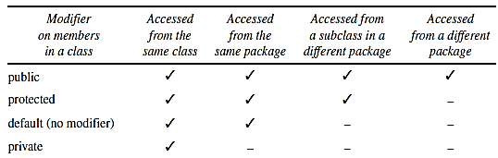
Classes, Inheritance, Package and Interfaces
Visibility modifiers

Slide 80
Classes, Inheritance, Package and Interfaces
Abstraction
Abstraction is a process of hiding the implementation details and showing only functionality to the user.
Abstraction lets you focus on what the object does instead of how it does it.
It shows only important things to user and hides internal details for example sending SMS, you just type the text and send the message. You don't know the internal processing about the message delivery. There are two ways to achieve abstraction in java:
Abstract class (0 to 100%)
Interface (100%)
We have noticed as far that the methods of superclass never gets called as it doesn’t have sufficient information to perform.

Slide 81
Classes, Inheritance, Package and Interfaces
In the inheritance hierarchy, classes become more specific and concrete with each new subclass from a subclass back up to a superclass, the classes become more general and less specific. Such a class determines the nature of methods that subclasses must implement.
So it is better to create a method without anybody. Such methods are known as abstract method and the class which contains at-least one abstract method are known as abstract class.
An abstract method is a method prototype without any implementation.
Its implementation is provided by the subclasses of the class in which it is declared.
To create an abstract method simply specify the modifier abstract followed by the method declaration without anybody.
Eg: abstract double area();

Slide 82
Classes, Inheritance, Package and Interfaces
A class containing at-least one abstract method is called abstract class.
A class is made abstract by putting the keyword abstract in front of the class keyword in the first line of class definition.
Example:
abstract class shape
{
abstract double area();
abstract double circumference();
}

Slide 83
Classes, Inheritance, Package and Interfaces
Abstract class is declared with abstract keyword.
It can have abstract and non-abstract methods.
Abstract Method contains no implementation, i.e., nobody.
Abstract Method is created to force same name and signature pattern in all the subclasses.
Subclasses have the flexibility to code these methods with their own specific requirements.
An abstract method cannot be contained in a non-abstract class.

Slide 84
Classes, Inheritance, Package and Interfaces
Abstract classes are like normal classes with fields and methods but we cannot create objects of abstract classes using the new operator. However you can declare a variable of an abstract class type. Such variables can be used to refer to an instance of any of the subclasses of abstract superclass.
Abstract classes are useful when we want to create a generic type that is used as a super class for two or more subclasses.
Example: AbstractDemo.java

Slide 85
Classes, Inheritance, Package and Interfaces
A subclass of an abstract class can be instantiated only of it overrides each of the abstract methods of its super class and provides an implementation for each of them. Such classes are called concrete classes.
If a subclass does not implement all the abstract methods that it inherits, the subclass must be specified as abstract.
An abstract method cannot be private, as private methods cannot be inherited and therefore cannot be overridden in the subclass.
Constructors and static methods cannot be declared abstract. As constructor cannot be inherited so an abstract constructor could never be implemented. Also as subclasses cannot override static methods, so an abstract static method cannot be implemented.
An abstract class has no use, no purpose unless it is extended. However, abstract superclass names can be used to invoke the static methods declared in those abstract super classes.

Slide 86
Classes, Inheritance, Package and Interfaces
Example of abstract class that have abstract method
Bike is an abstract class that contains only one abstract method run. It implementation is provided by the Honda class.
abstract class Bike
{
abstract void run();
}
public class honda extends Bike
{
void run()
{
System.out.println("running safely..");
}
public static void main(String args[])
{
Bike obj=new honda();
//reference to check instance of or object casting
//or honda obj=new honda();
obj.run();
}
}
Output: running safely..

Slide 87
Classes, Inheritance, Package and Interfaces
Example of abstract class having constructor, field and method
abstract class Bike
{
int limit=30;
Bike()
{
System.out.println("constructor is invoked”);
}
void getDetails()
{
System.out.println("it has two wheels”);
}
abstract void run();
}
class Honda extends Bike
{
void run()
{
System.out.println("running safely..”);
}
public static void main(String []args)
{
Bike obj=new Honda();
obj.run();
obj.getDetails();
System.out.println(obj.limit);
}
}

Slide 88
Classes, Inheritance, Package and Interfaces
Interfaces
Java expands the concept of the abstract classes with interfaces.
An Interface is similar to an abstract class. However, it contains only abstract method and constant (final fields).
It specifies what must be done but not how.
Once an interface is defined, class implements an interface by providing an implementation for each method declared by the interface.
Also one class can implement any number of interfaces.

Slide 89
Classes, Inheritance, Package and Interfaces
Interface have following advantages:
Interface is easier to work with than inheritance because we do not have to worry about providing any implementation details in the interface.
Interface facilitate multiple inheritance which is not possible with classes.
Interfaces allow objects of unrelated classes to be processed polymorphic ally.

Slide 90
Classes, Inheritance, Package and Interfaces
Interface contains only constants and abstract methods and is similar to an abstract class, but abstraction is 100% in an interface.
An interface is implicitly abstract. We do not need to use abstract keyword.
modifier interface Interface Name
{
/** Constant declarations */
/** Method signatures */
}
public interface Stack
{
public abstract void push(int item);
public abstract void pop();
}

Slide 91
Classes, Inheritance, Package and Interfaces
An interface is treated like a special class in Java. Each interface is compiled into a separate byte code file, just like a regular class.
Cannot create instance from an interface using the new operator.
Can be used as a data type for a reference variable.
Relationship between the class and the interface is known as interface inheritance (implements).

Slide 92
Classes, Inheritance, Package and Interfaces
Using the keyword interface, you can fully abstract a class’ interface from its implementation.
Interfaces are syntactically similar to classes, but they lack instance variables but can have constants and their methods are declared without anybody.
It has:
static, final, public constants an variables can be declared inside of interface declarations. They are implicitly final and static, meaning they cannot be changed by the implementing class . They must also be initialized with a constant value
A constant defined in an interface can be accessed using the syntax InterfaceName. CONSTANT_NAME
abstract public methods and
cannot be instantiated just like abstract class.
Methods are non static because need to override them in derived class.
– Each method in an interface is also implicitly abstract and public, so abstract and public keyword is not needed.
Interface fields are public, static and final by default
Methods are public and abstract and
cannot be instantiated just like abstract class.

Slide 93
Classes, Inheritance, Package and Interfaces
Defining Interfaces
An interface is just defined as a class but a keyword interface is used instead of class.
All the methods in an interface are public and abstract by default and all the fields are public, static and final by default.
Syntax:
[public] interface InterfaceName
{
//constant variable declaration
//abstract method declaration
}

Slide 94
Classes, Inheritance, Package and Interfaces
Interface is basically kind of class but it can define only abstract methods (only method declaration, no method body) and final fields. It’s responsibility of class that implement an interface to define code for implementation of these abstract methods.
interface item
{
final int code=101;
final String name="KRITI";
void put();
float compute(float x, float y);
}
All data fields are public final static and all methods are public abstract in an interface, Java allows these modifiers to be omitted.

Slide 95
Classes, Inheritance, Package and Interfaces
Implementing Interface
An interface provides nothing but abstract method declaration so all the methods are to be implemented in there own classes.
To do so, include the keyword implements.
If a class does not implement all of the methods of the interface ,the class must declare itself as abstract.
[access specifier][modified] class ClassName implements InterfaceName
{
//provide the implementation for method in interface
}

Slide 96
Classes, Inheritance, Package and Interfaces
public class Mammal implements Animal
{
public void eat()
{
System.out.println("Mammal eats");
}
public void travel()
{
System.out.println("Mammal travels");
}
public int noOfLegs()
{
return 0;
}
public static void main(String args[])
{
Mammal m = new Mammal();
m.eat();
m.travel();
}
}

Slide 97
Classes, Inheritance, Package and Interfaces
Multiple Inheritance can be implemented through interfaces because there is no ambiguity as implementation is provided by implementation class.
interface Printable
{
void print();
}
interface Showable
{
void print();
}
class TestInterface3 implements Printable, Showable
{
public void print()
{
System.out.println(“Hello");
}
public static void main(String args[])
{
TestInterface3 obj = new TestInterface3();
obj.print();
}
}

Slide 98
Classes, Inheritance, Package and Interfaces
Extending Interfaces
When one interface inherits from another interface the sub-interface inherits all the methods and constants that its super interface declared.
In addition it can also declare new abstract methods and constants.
To extend the interface use the keyword extends.
An interface can inherit other interfaces using the extends keyword.
A class implementing any Interface must implement all the abstract methods defined in Interface(Interface1, …. and InterfaceName).
An interface can extend other interfaces but not classes.
A class can extend its superclass and implement multiple interfaces.

Slide 99
Classes, Inheritance, Package and Interfaces
interface NewsPaper
{
news();
}
interface Magazine extends NewsPaper
{
colorful();
}

Slide 100
Classes, Inheritance, Package and Interfaces
Abstract class | Interface
Abstract class is a class which contain one or more abstract methods, which has to be implemented by its sub classes. | Interface is a Java Object containing method declaration but no implementation. The classes which implement the Interfaces must provide the method definition for all the methods.
Abstract class is a Class prefix with an abstract keyword followed by Class definition. | Interface is a pure abstract class which starts with interface keyword.
Abstract class can also contain concrete methods. | Whereas, Interface contains all abstract methods and final variable declarations.
Abstract classes are useful in a situation that Some general methods should be implemented and specialization behavior should be implemented by child classes. | Interfaces are useful in a situation that all properties should be implemented.

Slide 101
Classes, Inheritance, Package and Interfaces
Self Assessment Questions
Which of the following is correct way of implementing an interface salary by class manager?
class manager extends salary {}
class manager implements salary {}
class manager imports salary {}
None of the mentioned.
Answer: class manager implements salary {}

Slide 102
Classes, Inheritance, Package and Interfaces
Self Assessment Questions
Which of the following is incorrect statement about packages?
Interfaces specifies what class must do but not how it does.
Interfaces are specified public if they are to be accessed by any code in the program.
All variables in interface are implicitly final and static.
All variables are static and methods are public if interface is defined pubic
Answer: All variables are static and methods are public if interface is defined pubic

Slide 103
Classes, Inheritance, Package and Interfaces
Self Assessment Questions
State whether the following statements about the advantages of organizing classes into packages are True or False.
Two classes in two different packages can not have the same name.
The classes contained in the packages of other programs can be easily reused.
True, False
False, True
True, True
False, False
Answer: False, True

Slide 104
Classes, Inheritance, Package and Interfaces
Self Assessment Questions
By convention, java packages begin with ………………. letters while all the class names begin with an ………………… letter.
uppercase, uppercase
lowercase, lowercase
uppercase, lowercase
lowercase, uppercase
Answer: lowercase, uppercase

Slide 105
Classes, Inheritance, Package and Interfaces
Self Assessment Questions
If a class that implements an interface does not implement all the methods of the interface, then the class becomes a/an …………………….. class.
abstract
final
Static
Super
Answer: abstract

Slide 106

Classes, Inheritance, Package and Interfaces
Document Links
Topics | URL | Notes
Classes and Objects | http://www.w3schools.in/java/object-classes/ | This link will give detailed information of classes and objects in java.
Constructors | http://www.programmingsimplified.com/java/tutorial/java-constructor-tutorial | The given link is complete insight of what constructor is and how it works.
Inheritance | http://beginnersbook.com/2013/03/inheritance-in-java/ | The concept of inheritance is fully explained here with all its types.
Package and Interfaces | http://www.jarticles.com/package/package_eng.html | The concept of packages and interfaces are fully covered in the link given. All the syntax and other important keywords are covered as well with examples.

Slide 107

Classes, Inheritance, Package and Interfaces
Video Links
Topics | URL | Notes
Classes and objects | https://www.youtube.com/watch?v=4XRy-TdfU0I | This video explain about Classes, object and inheritance with real time example.
Methods | www.youtube.com/watch?v=5VLjM4Plyxg | This video explain about different methods and its implementation.
Inheritance | https://www.youtube.com/watch?v=aFZ-0bbSLi8 | This video explain about Classes, object and inheritance with real time example.
Packages and interfaces | www.youtube.com/watch?v=Yaa3QroWe7Q | All the insights about packages and interfaces are given in this video.

Slide 108
Classes, Inheritance, Package and Interfaces
E-Book Links
Topics | URL
Classes and objects | http://www.oracle.com/technetwork/java/javase/downloads/java-se-7-tutorial-2012-02-28-1536013.html
Inheritance | http://www.oracle.com/technetwork/java/javase/java-tutorial-downloads-2005894.html
Packages and interfaces | http://greenteapress.com/thinkapjava/thinkapjava.pdf

